Slide 1
What the data say about police brutality and racial bias — and which reforms might work
Team # 1:
Russell Jamadar, Myung Sub Cho, Yash Salvi

Slide 2
OVERVIEW
Recently in the US, there has been a lot of protests and events to defund the police. Protesters claiming the police shootings are targeting people of color and trying to criminalize them. In our project we are analyzing five years data on police shooting in the US and trying to understand if the claims are authentic and trying to understand the variable which led police to shoot at people.
Notes:
is actually getting done

Slide 3
Data
Our data contains basic information of the individual, their age, gender and race along with how they were shot, if they attacked the officer, if they were holding weapons and if they have shown any mental illness, was the incident recorded, did the suspect flee and the type of weapon suspects were carrying.

Slide 4
Findings Summary
Most number of people shot by police are white by count.
Most number of people shot by police are black by percentage.
Most of the victims who were shot by the police appeared to be armed followed by attacking the police and trying to flee.
Fleeing the scene is mostly related to black.

Slide 5
The Numbers
We have used Tableau to understand the variable importance and have also used regression models on R. More than 73% of the population is White. So even the number of White people who shot by police is the most, it does not mean that White experiences police power abuse relatively more than others. So, our team decide to divide each of value by racial ratio. And we discovered Black race experience police shooting relatively higher than any other race and white is ranked number four.

Slide 6
Variables
A csv file from Kaggle.com containing following variables:
id - Serial number of the data
name - Name of the shot person
date - Date incidence occurred
manner_of_death - How victim was killed
armed - Weapons on the victim
armed_factor - “1” means victim is armed, “0” is not
age - Age of the victim
gender - Gender of the victim
race - race of the victim
flee_factor – “1” means victim flee, “0” is not
black – Victim is Black
white – Victim is White
city - US city of the incidence
state - US state of the incidence
signs_of_mental_illness - if the victim showed any sign of mental illness
mental_illness - “1” means victim shows mental illness symtoms, “0” is not
threat_level - if the victim attacked the law enforcement officer
flee - if the victim tried to flee the scene
body_cam - if law enforcement officer had body camera on

Slide 7
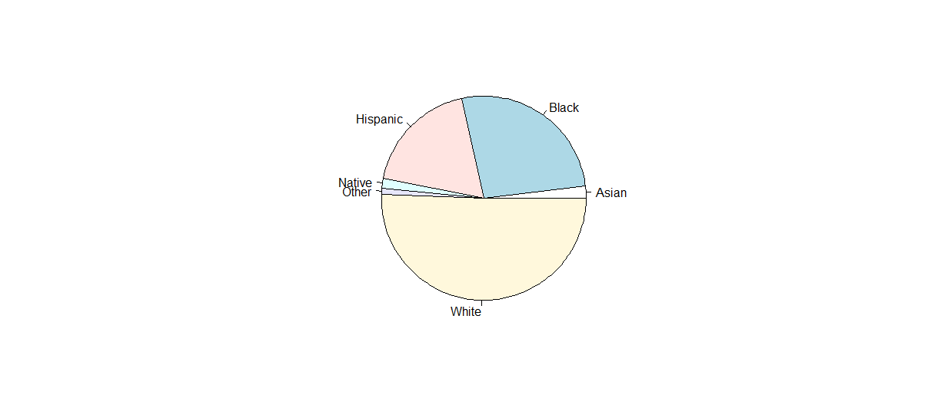
Findings
The pie chart which represent each share of police shooting by race. Number of white is the most. US population is very biased. More than 75% of the population is White. So even the number of white people who shot by police is the most, it does not mean that White experiences police power abuse relatively more than others.

Slide 8
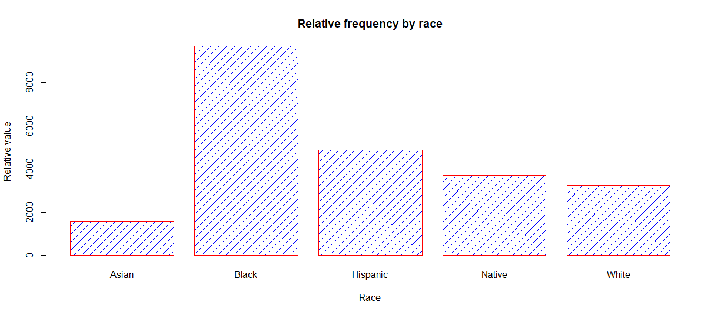
Findings Cont.
Now we can see the relative frequency by race. Black people experience police shooting relatively higher than any other race. So, it is true that there is discrimination.

Slide 9
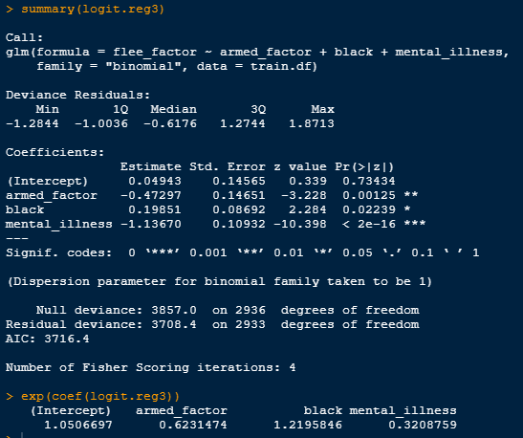
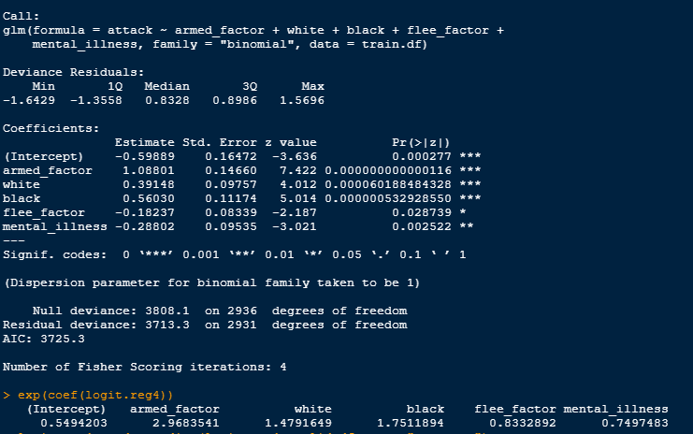
Findings Cont.
We build several models to find why police shooting happened.

Slide 10
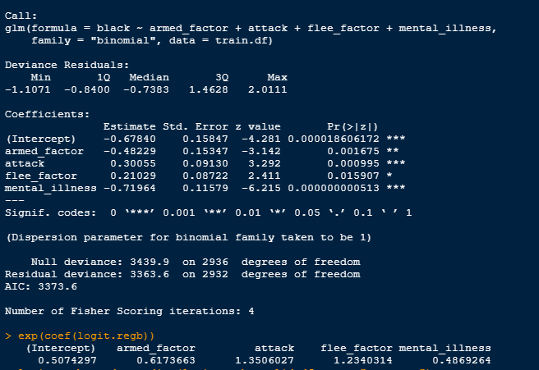
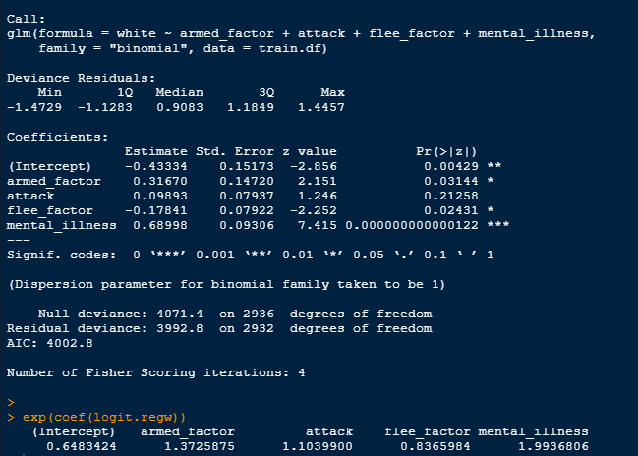
Black VS White

Slide 11
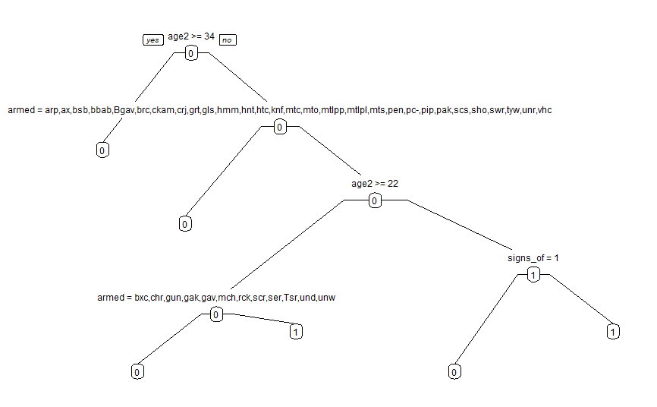
Findings Cont.
The decision tree model was run on Black victims who were unarmed and without mental illness symptoms are more likely black.

Slide 12
Conclusion
The rate of fatal police shootings in the United States shows large differences based on ethnicity. Among Black Americans, the rate of fatal police shootings is higher than any other race. While the rate is relatively very low for White Americans.
We recommend use of alternative weapons to catch the fleeing suspect, example: taser gun, rubber bullets, etc. Citizens cooperation is always required by law enforcement, officers should communicate with public to bring awareness at local level. Police should use body camera at all time.
Instead of defunding the police, we should invest more in law enforcement in research, alternative weapons, and communication. Law enforcement officers should take classes in diversity and inclusion and the department should be well diversified by race, religion, and ethnicity.

